Slide 1
MML minor #6
Свёрточные (продолжение) и рекуррентные нейронные сети

Slide 2
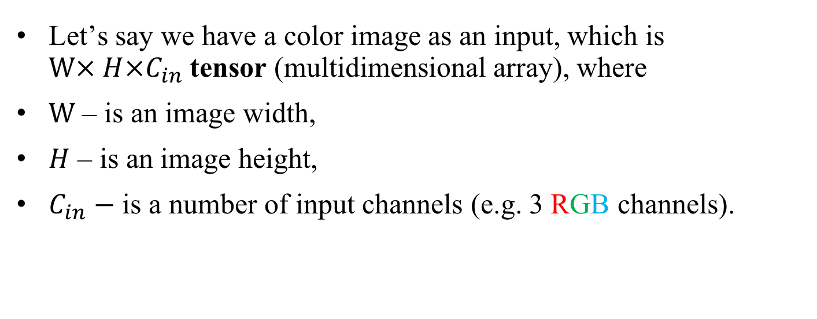
A color image input
Let’s say we have a color image as an input, which is $W× H×C_{in}$ tensor (multidimensional array), where
$W$ – is an image width,
$H$ – is an image height,
$C_{in}−$ is a number of input channels (e.g. 3 RGB channels).

Slide 3
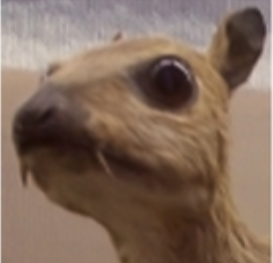

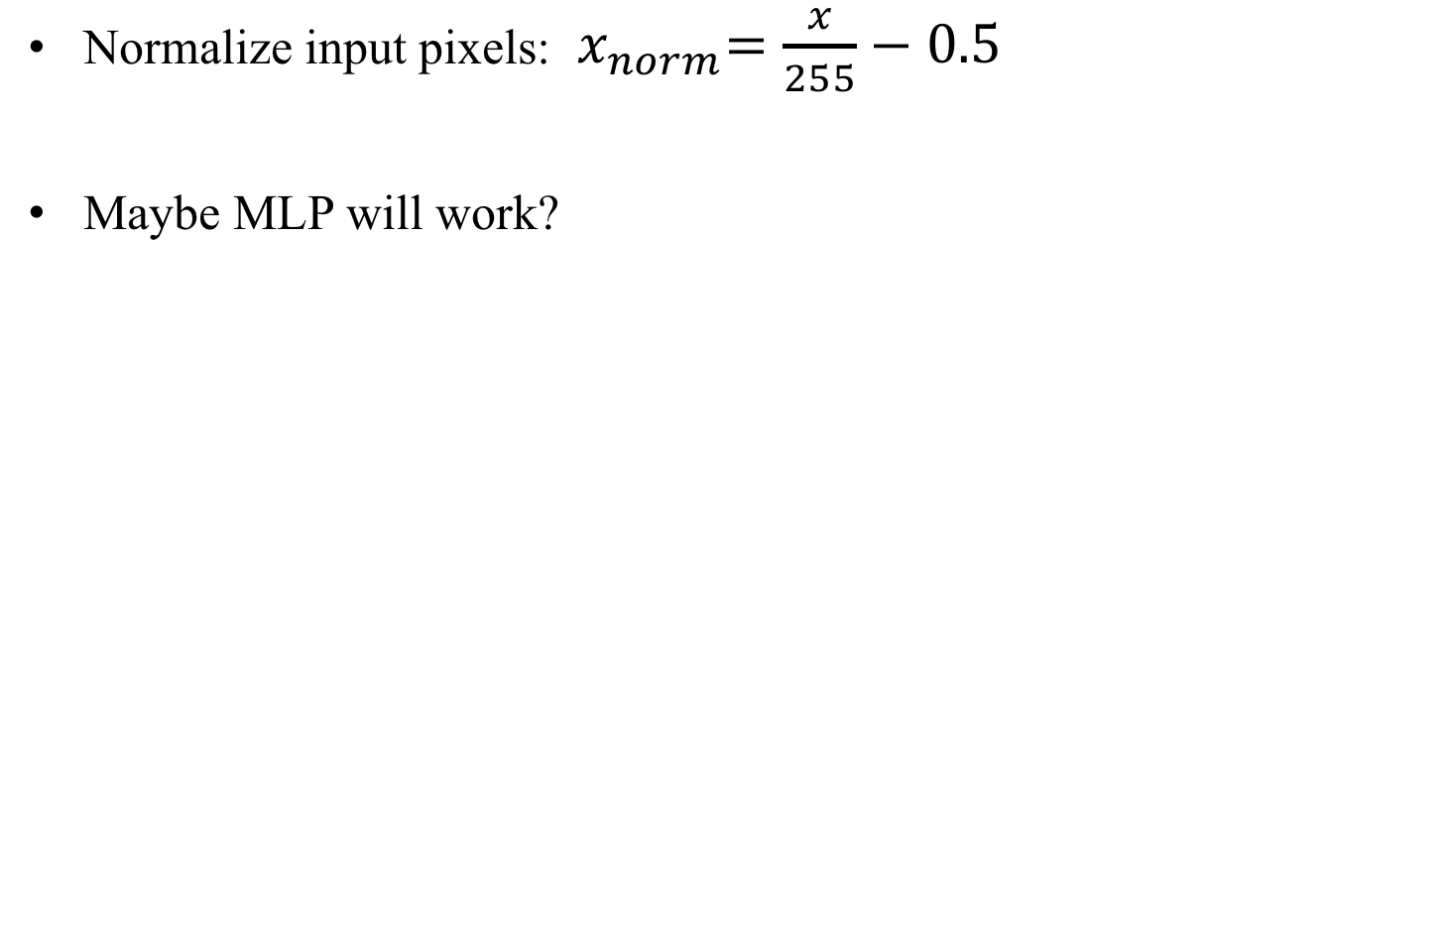
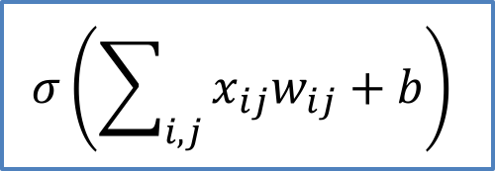
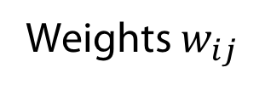
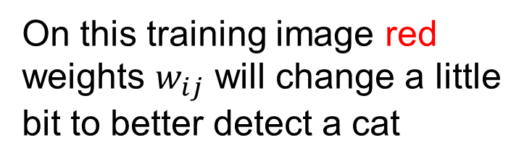
A color image input
Let’s say we have a color image as an input, which is $W× H×C_{in}$ tensor (multidimensional array), where
$W$ – is an image width,
$H$ – is an image height,
$C_{in}−$ is a number of input channels (e.g. 3 RGB channels).
-1 | -1 | -1
-1 | 8 | -1
-1 | -1 | -1
$$H$$
*
=
$$C_{in}$$
$$W$$
kernel of size
$$W_{k}× H_{k}×C_{in}$$
feature map

Slide 4
A color image input
Let’s say we have a color image as an input, which is $W× H×C_{in}$ tensor (multidimensional array), where
$W$ – is an image width,
$H$ – is an image height,
$C_{in}−$ is a number of input channels (e.g. 3 RGB channels).
-1 | -1 | -1
-1 | 8 | -1
-1 | -1 | -1
$$H$$
*
=
$$C_{in}$$
$$W$$
kernel of size
$$W_{k}× H_{k}×C_{in}$$
feature map

Slide 5
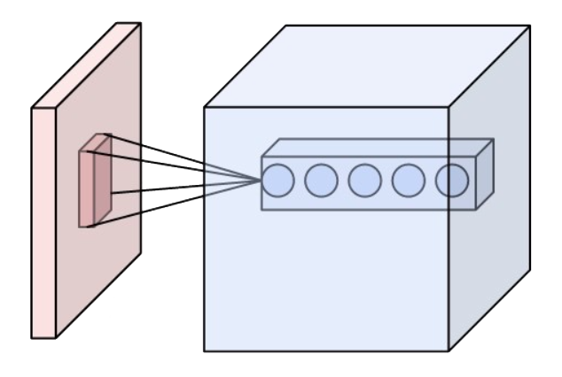
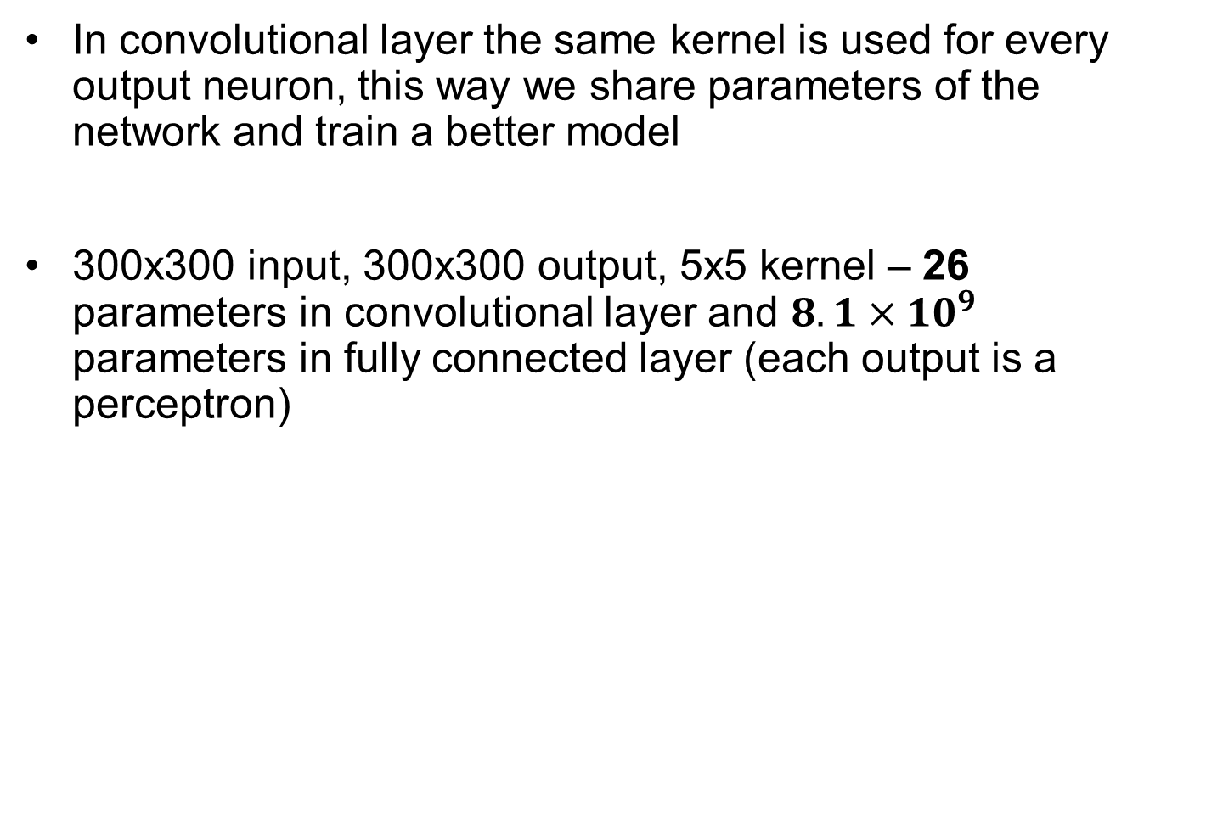
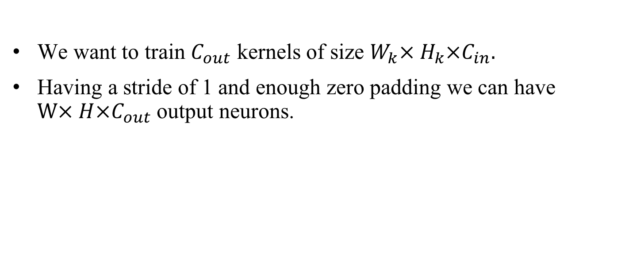
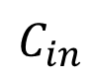
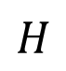
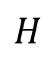
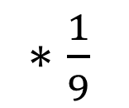

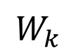
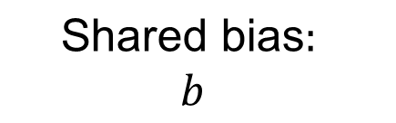
One kernel is not enough!
We want to train $C_{out}$ kernels of size $W_{k}× H_{k}×C_{in}.$
Having a stride of 1 and enough zero padding we can have $W× H×C_{out}$ output neurons.
feature map
$$W$$
$$W$$
neuron
$$W_{k}$$
$$H_{k}$$
$$H$$
$$H$$
$$C_{out}$$
$$C_{in}$$

Slide 6
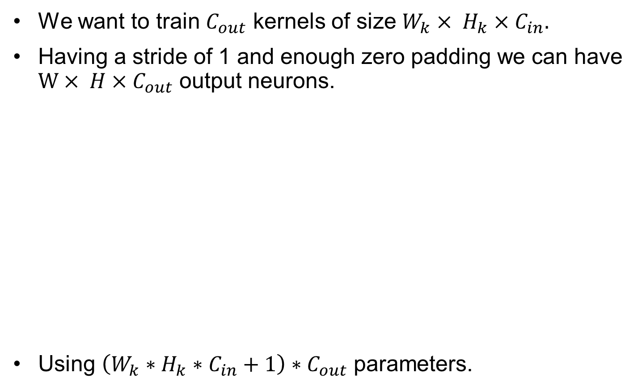
One kernel is not enough!
We want to train $C_{out}$ kernels of size $W_{k}× H_{k}×C_{in}.$
Having a stride of 1 and enough zero padding we can have $W× H×C_{out}$ output neurons.
Using $\left(W_{k}∗H_{k}∗C_{in}+1\right)∗C_{out}$ parameters.
feature map
$$W$$
$$W$$
neuron
$$W_{k}$$
$$H_{k}$$
$$H$$
$$H$$
$$C_{out}$$
$$C_{in}$$

Slide 7
One convolutional layer is not enough!
Let’s say neurons of the 1st convolutional layer look at the patches of the image of size 3x3.
What if an object of interest is bigger than that?
We need a 2nd convolutional layer on top of the 1st!

Slide 8
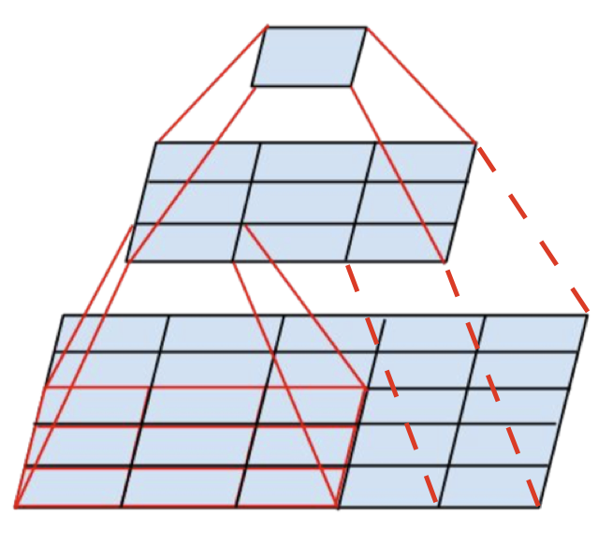
One convolutional layer is not enough!
Let’s say neurons of the 1st convolutional layer look at the patches of the image of size 3x3.
What if an object of interest is bigger than that?
We need a 2nd convolutional layer on top of the 1st!
2nd 3x3 conv
receptive field 5x5
1st 3x3 conv
receptive field 3x3

Slide 9
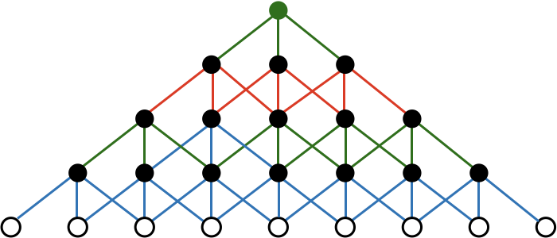
Receptive field after N convolutional layers
4th
1x9
3rd
1x7
Receptive field
2nd
1x5
1st 1x3 conv layer
1x3
inputs
(1 dimensional)

Slide 10
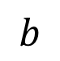
Receptive field after N convolutional layers
4th
1x9
3rd
1x7
Receptive field
2nd
1x5
1st 1x3 conv layer
1x3
inputs
(1 dimensional)
If we stack $N$ convolutional layers with the same kernel size 3x3 the receptive field on $N$-th layer will be $2N+1×2N+1.$
It looks like we need to stack a lot of convolutional layers! To be able to identify objects as big as the input image 300x300 we will need 150 convolutional layers!

Slide 11
We need to grow receptive field faster!
We can increase a stride in our convolutional layer to reduce the output dimensions!
Stride: 2
1 | 1 | 1 | 4
2 | 6 | 5 | 8
3 | 2 | 1 | 0
1 | 1 | 3 | 5
7 | 9
4 | 6
2x2 conv

Slide 12
We need to grow receptive field faster!
We can increase a stride in our convolutional layer to reduce the output dimensions!
Further convolutions will effectively double their receptive field!
Stride: 2
1 | 1 | 1 | 4
2 | 6 | 5 | 8
3 | 2 | 1 | 0
1 | 1 | 3 | 5
2x2 conv
7 | 9
4 | 6
2x2 conv

Slide 13
How do we maintain translation invariance?
0 | 0 | 0 | 0
0 | 0 | 0 | 0
0 | 0 | 1 | 0
0 | 0 | 0 | 1
0 | 0 | 0
0 | 1 | 0
0 | 0 | 2
1 | 0
0 | 1
*
=
Max = 2
Kernel
Output
Input
Didn’t change
1 | 0 | 0 | 0
0 | 1 | 0 | 0
0 | 0 | 0 | 0
0 | 0 | 0 | 0
2 | 0 | 0
0 | 1 | 0
0 | 0 | 0
1 | 0
0 | 1
*
=
Max = 2
Kernel
Output
Input

Slide 14
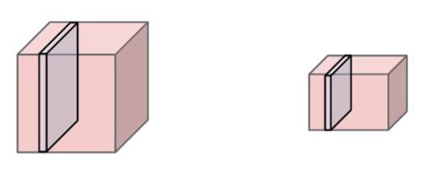
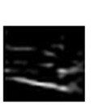
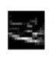
Pooling layer will help!
This layer works like a convolutional layer but doesn’t have kernel, instead it calculates maximum or average of input patch values.
Single depth slice
200x200x64
100x100x64
1 | 1 | 1 | 4
2 | 6 | 5 | 8
3 | 2 | 1 | 0
1 | 1 | 3 | 5
pooling
6 | 8
3 | 5
200
100
downsampling
100
200
2x2 max pooling with stride 2

Slide 15
Backpropagation for max pooling layer
Strictly speaking: maximum is not a differentiable function!

Slide 16
Backpropagation for max pooling layer
Strictly speaking: maximum is not a differentiable function!
There is no gradient with respect to non maximum patch neurons, since changing them slightly does not affect the output.
6 | 8
3 | 5
7 | 8
3 | 5
Maximum = 8
Maximum = 8

Slide 17
Backpropagation for max pooling layer
Strictly speaking: maximum is not a differentiable function!
There is no gradient with respect to non maximum patch neurons, since changing them slightly does not affect the output.
For the maximum patch neuron we have a gradient of 1.
6 | 8
3 | 5
7 | 8
3 | 5
Maximum = 8
Maximum = 8
6 | 8
3 | 5
7 | 9
3 | 5
Maximum = 8
Maximum = 9

Slide 18
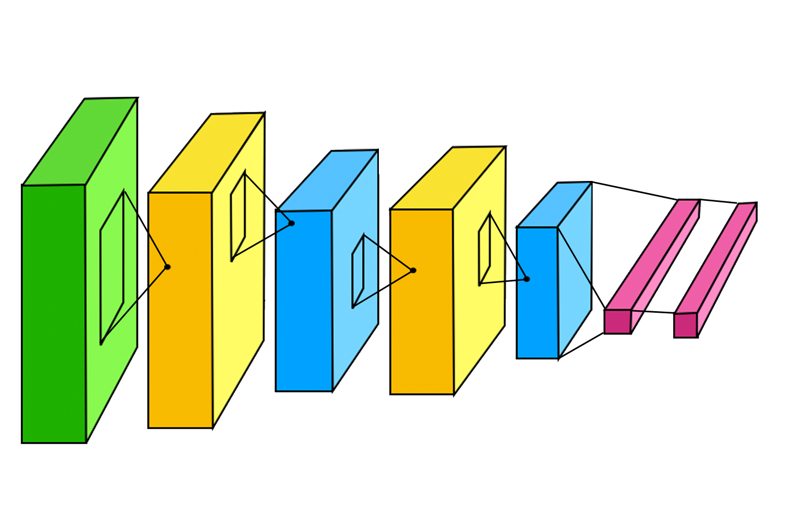

Putting it all together into a simple CNN
LeNet-5 architecture (1998) for handwritten digits recognition on MNIST dataset:
32
28
14
10
5
5
2
5
2
2
5
5
2
28
14
10
5
32
120
84
16
fc1
fc2
6
16
pool2
2x2
6
pool1
2x2
conv2
5x5
10
1
conv1
5x5
fc3 + softmax
http://yann.lecun.com/exdb/publis/pdf/lecun-98.pdf

Slide 19
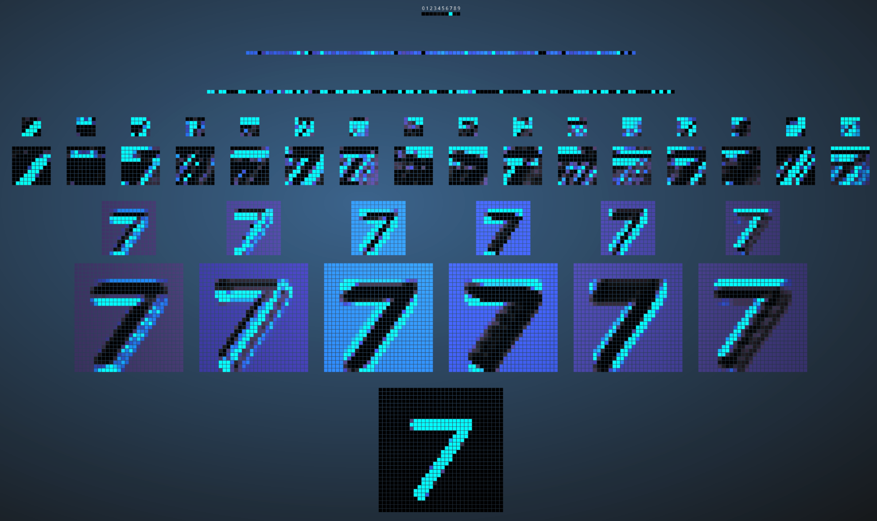
Визуализация обученной сети для MNIST
http://scs.ryerson.ca/~aharley/vis/conv/flat.html

Slide 20
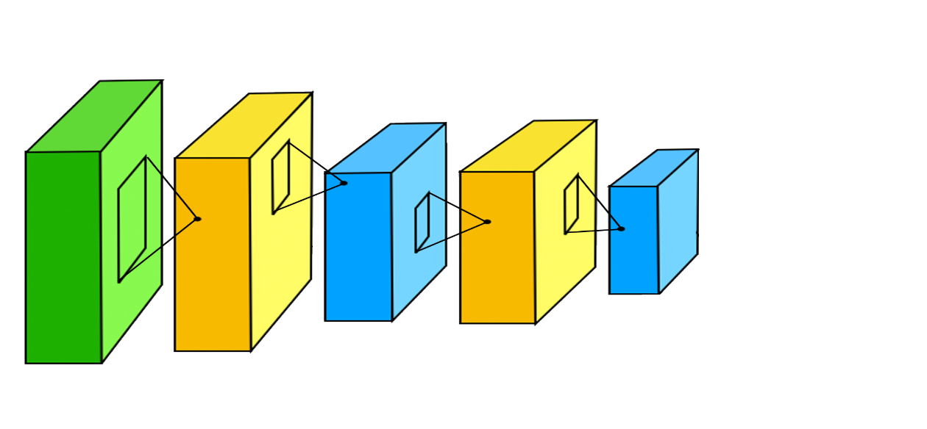
Learning deep representations
Neurons of deep convolutional layers learn complex representations that can be used as features for classification with MLP.
Automatic feature extraction
Good features
for MLP
Inputs that provide highest activations:
conv1
conv2
conv3
http://web.eecs.umich.edu/~honglak/icml09-ConvolutionalDeepBeliefNetworks.pdf

Slide 21
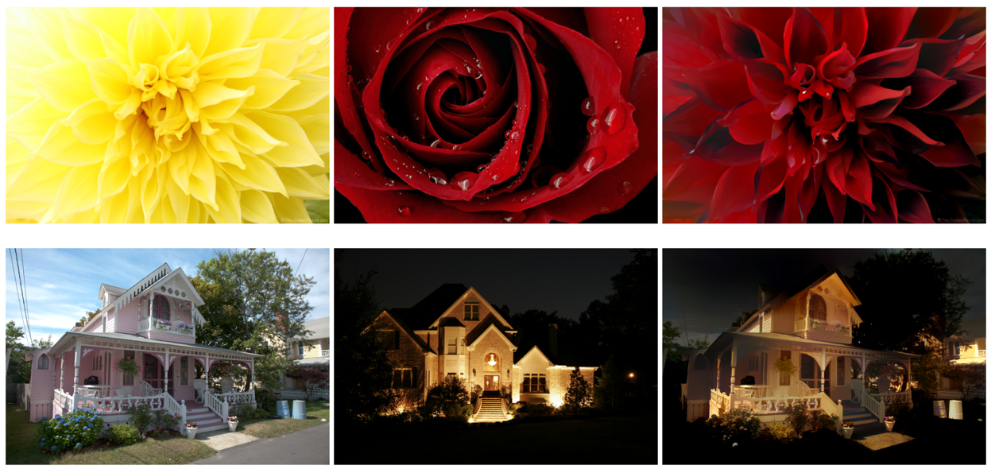
Современные применения: перенос стиля
Картинка
Стиль
Картинка со стилем
https://github.com/luanfujun/deep-photo-styletransfer

Slide 22
Еще примеры применений
https://quickdraw.withgoogle.com
https://affinelayer.com/pixsrv/

Slide 23
Recurrent Neural Networks (RNN)
Работают с последовательностями
Слов в предложении
Букв в предложении
Отсчетов в аудио сигнале (амплитуда, частота)
Пикселей изображения
…

Slide 24
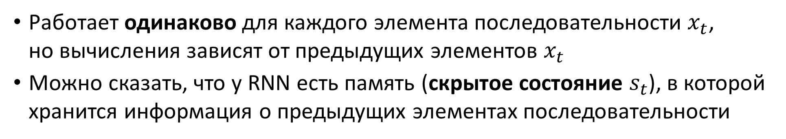
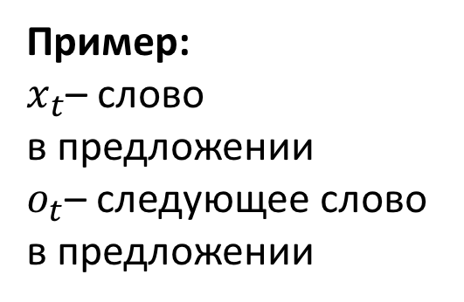
Как устроена простая RNN
Пример: $x_{t}$– слово в предложении
$o_{t}$– следующее слово в предложении
Работает одинаково для каждого элемента последовательности $x_{t}$, но вычисления зависят от предыдущих элементов $x_{t}$
Можно сказать, что у RNN есть память (скрытое состояние $s_{t}$), в которой хранится информация о предыдущих элементах последовательности
http://www.wildml.com/2015/09/recurrent-neural-networks-tutorial-part-1-introduction-to-rnns/

Slide 25
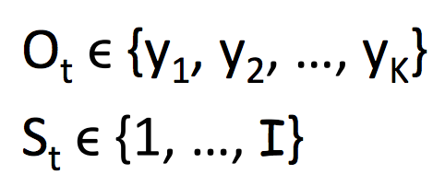
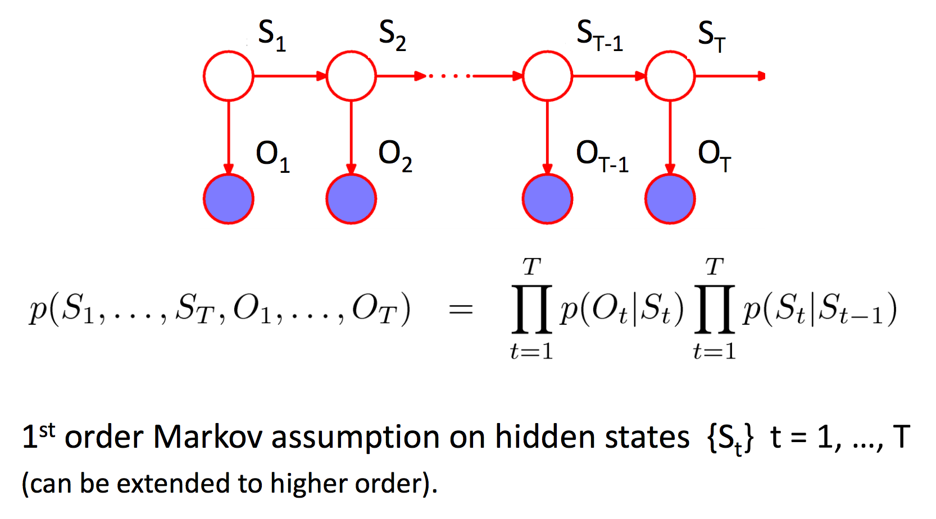
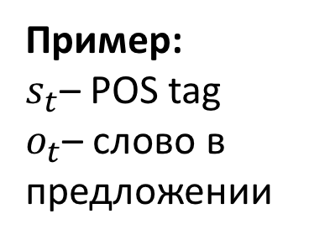
А как же Hidden Markov Model (HMM)?
Пример: $s_{t}$– POS tag
$o_{t}$– слово в предложении
http://blog.echen.me/2012/01/03/introduction-to-conditional-random-fields/
http://www.cs.cmu.edu/~aarti/Class/10701/slides/Lecture17.pdf

Slide 26
Backpropagation through time (BPTT)
Если развернуть сеть по времени t, то получим обычную feed-forward сеть с shared параметрами
Применяем backpropagation, считаем градиенты для каждого параметра
Далее (так же, как в случае сверток CNN) суммируем градиенты по shared параметрам и делаем шаг SGD
https://en.wikipedia.org/wiki/Backpropagation_through_time

Slide 27
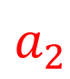
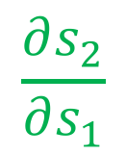
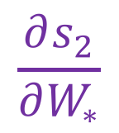
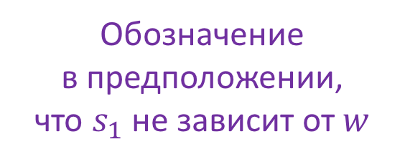
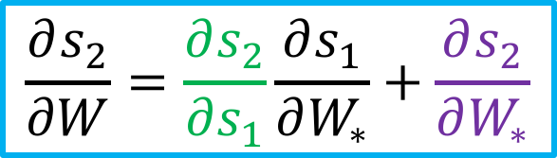
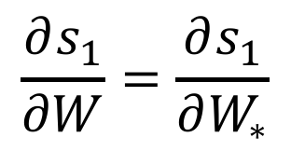
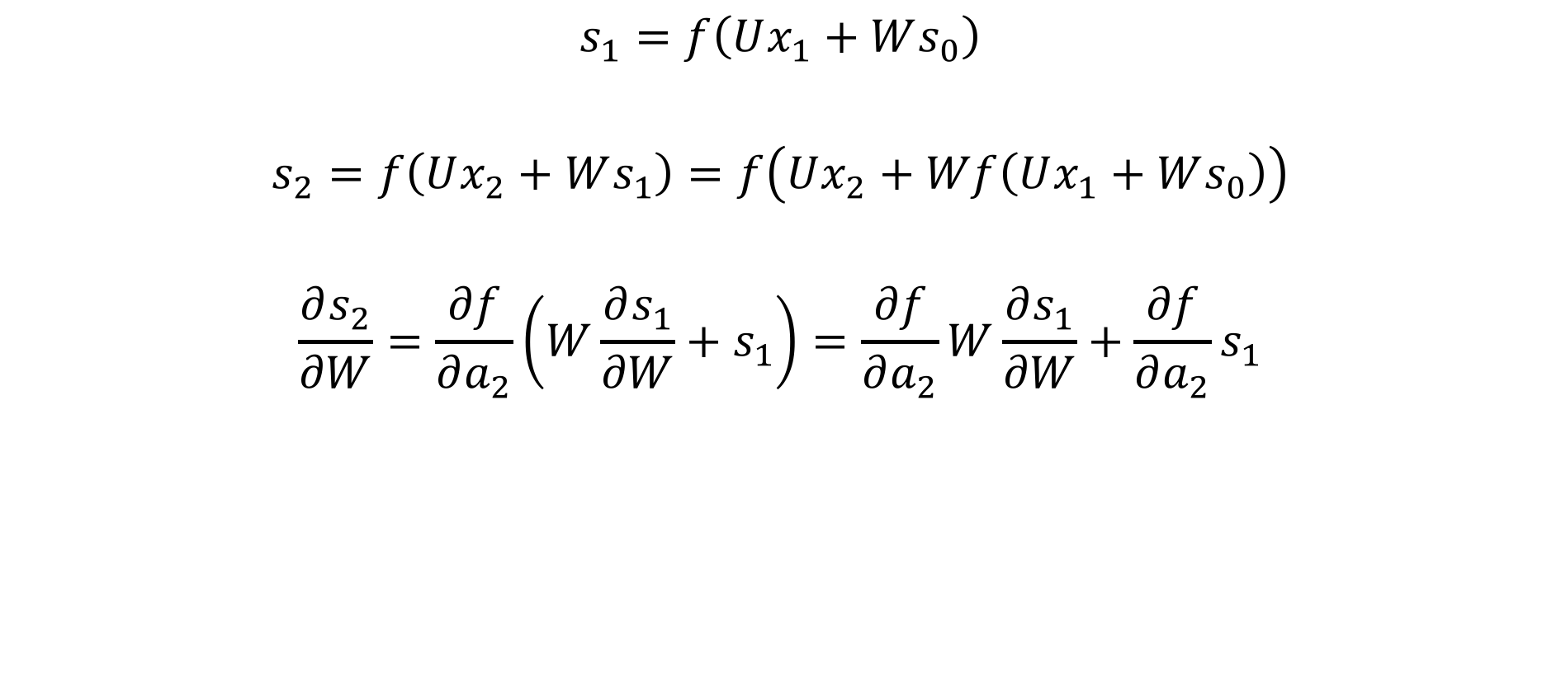
Посчитаем производную для 2 шагов
$$s_{1}=f\left(Ux_{1}+Ws_{0}\right)$$
$$s_{2}=f\left(Ux_{2}+Ws_{1}\right)=f\left(Ux_{2}+Wf\left(Ux_{1}+Ws_{0}\right)\right)$$
$$\frac{∂s_{2}}{∂W}=\frac{∂f}{∂a_{2}}\left(W\frac{∂s_{1}}{∂W}+s_{1}\right)=\frac{∂f}{∂a_{2}}W\frac{∂s_{1}}{∂W}+\frac{∂f}{∂a_{2}}s_{1}$$
$$a_{2}$$
$$\frac{∂s_{1}}{∂W}=\frac{∂s_{1}}{∂W_{∗}}$$
$$\frac{∂s_{2}}{∂s_{1}}$$
$$\frac{∂s_{2}}{∂W_{∗}}$$
Обозначение в предположении,
что $s_{1}$ не зависит от $w$
$$\frac{∂s_{2}}{∂W}=\frac{∂s_{2}}{∂s_{1}}\frac{∂s_{1}}{∂W_{∗}}+\frac{∂s_{2}}{∂W_{∗}}$$

Slide 28
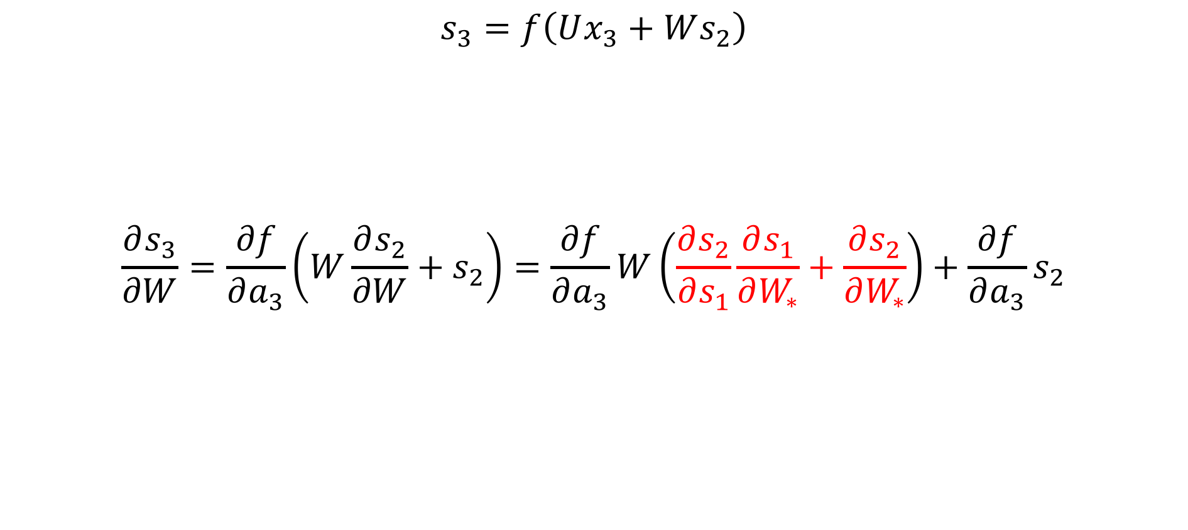
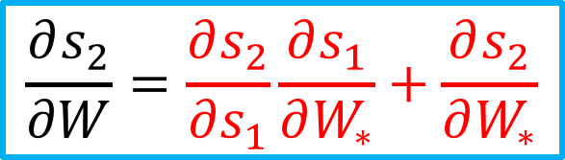
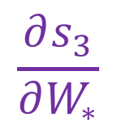
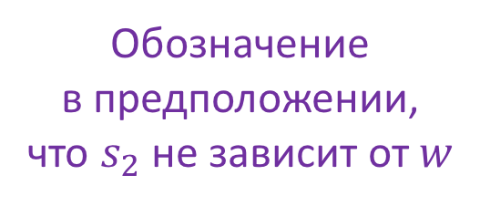
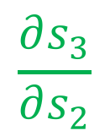
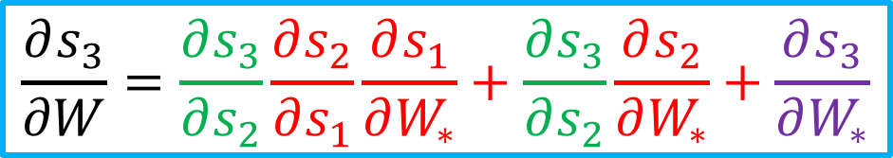
Посчитаем производную для 3 шагов
$$s_{3}=f\left(Ux_{3}+Ws_{2}\right)$$
$$\frac{∂s_{3}}{∂W}=\frac{∂f}{∂a_{3}}\left(W\frac{∂s_{2}}{∂W}+s_{2}\right)=\frac{∂f}{∂a_{3}}W\left(\frac{∂s_{2}}{∂s_{1}}\frac{∂s_{1}}{∂W_{∗}}+\frac{∂s_{2}}{∂W_{∗}}\right)+\frac{∂f}{∂a_{3}}s_{2}$$
$$\frac{∂s_{2}}{∂W}=\frac{∂s_{2}}{∂s_{1}}\frac{∂s_{1}}{∂W_{∗}}+\frac{∂s_{2}}{∂W_{∗}}$$
$$\frac{∂s_{3}}{∂s_{2}}$$
$$\frac{∂s_{3}}{∂W_{∗}}$$
Обозначение в предположении,
что $s_{2}$ не зависит от $w$
$$\frac{∂s_{3}}{∂W}=\frac{∂s_{3}}{∂s_{2}}\frac{∂s_{2}}{∂s_{1}}\frac{∂s_{1}}{∂W_{∗}}+\frac{∂s_{3}}{∂s_{2}}\frac{∂s_{2}}{∂W_{∗}}+\frac{∂s_{3}}{∂W_{∗}}$$

Slide 29
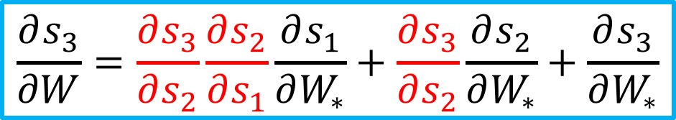
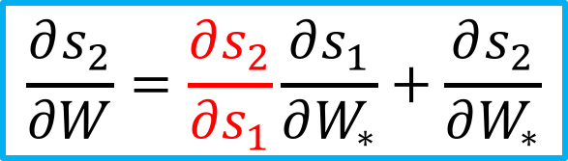
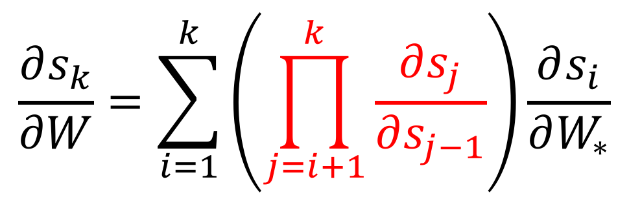
Индукцией легко показать, что…
$$\frac{∂s_{2}}{∂W}=\frac{∂s_{2}}{∂s_{1}}\frac{∂s_{1}}{∂W_{∗}}+\frac{∂s_{2}}{∂W_{∗}}$$
$$\frac{∂s_{3}}{∂W}=\frac{∂s_{3}}{∂s_{2}}\frac{∂s_{2}}{∂s_{1}}\frac{∂s_{1}}{∂W_{∗}}+\frac{∂s_{3}}{∂s_{2}}\frac{∂s_{2}}{∂W_{∗}}+\frac{∂s_{3}}{∂W_{∗}}$$
$$\frac{∂s_{k}}{∂W}=\sum_{i=1}^{k}{\left(\prod_{j=i+1}^{k}{\frac{∂s_{j}}{∂s_{j−1}}}\right)}\frac{∂s_{i}}{∂W_{∗}}$$

Slide 30
BPTT на примере
http://www.wildml.com/2015/10/recurrent-neural-networks-tutorial-part-3-backpropagation-through-time-and-vanishing-gradients/

Slide 31
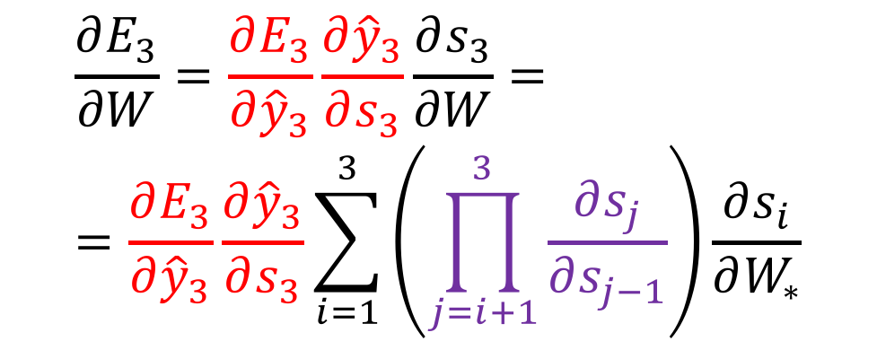
BPTT на примере
$$\frac{∂E_{3}}{∂W}=\frac{∂E_{3}}{∂{\hat{y}}_{3}}\frac{∂{\hat{y}}_{3}}{∂s_{3}}\frac{∂s_{3}}{∂W}==\frac{∂E_{3}}{∂{\hat{y}}_{3}}\frac{∂{\hat{y}}_{3}}{∂s_{3}}\sum_{i=1}^{3}{\left(\prod_{j=i+1}^{3}{\frac{∂s_{j}}{∂s_{j−1}}}\right)}\frac{∂s_{i}}{∂W_{∗}}$$
http://www.wildml.com/2015/10/recurrent-neural-networks-tutorial-part-3-backpropagation-through-time-and-vanishing-gradients/

Slide 32
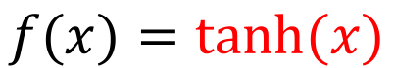
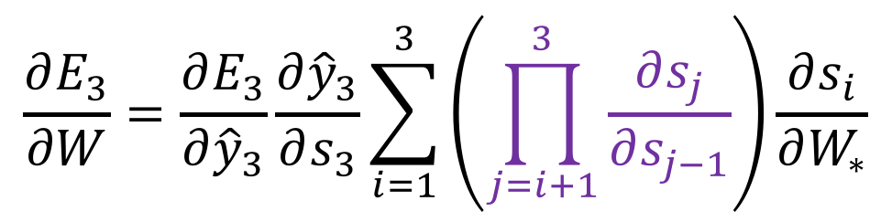



Проблема с затухающими градиентами
$$\frac{∂E_{3}}{∂W}=\frac{∂E_{3}}{∂{\hat{y}}_{3}}\frac{∂{\hat{y}}_{3}}{∂s_{3}}\sum_{i=1}^{3}{\left(\prod_{j=i+1}^{3}{\frac{∂s_{j}}{∂s_{j−1}}}\right)}\frac{∂s_{i}}{∂W_{∗}}$$
$$s_{t}=\tanh\left(Ux_{t}+Ws_{t−1}\right)$$
$$\frac{∂s_{j}}{∂s_{j−1}}=\frac{∂f}{∂a_{j}}W$$
$$f(x)=tanh⁡(x)$$
$$\prod_{j=i+1}^{3}{\frac{∂s_{j}}{∂s_{j−1}}}$$
Быстро убывает или взрывается
http://www.wildml.com/2015/10/recurrent-neural-networks-tutorial-part-3-backpropagation-through-time-and-vanishing-gradients/

Slide 33


Gradient clipping
Градиенты могут взорваться – ограничим их норму
https://arxiv.org/pdf/1211.5063.pdf

Slide 34

Простая RNN плохо работает
$$h_{t}=tanh⁡(Ux_{t}+Wh_{t−1})$$

Slide 35
Спасет LSTM

Slide 36

LSTM решает проблему затухания градиентов
Распространение ошибки на 128 шаге
https://imgur.com/gallery/vaNahKE

Slide 37

LSTM cell state
$C_{t}$ проходит через все ячейки, LSTM может забывать или добавлять информацию в $C_{t}$
Gates учат маски для забывания (forget), добавления (input) и вывода (output) вектора состояний $C_{t}$

Slide 38
LSTM forget gate

Slide 39
LSTM input gate и вклад ячейки в состояние

Slide 40
Обновление состояния

Slide 41
Выдача скрытого состояния наружу

Slide 42

Encoder-decoder (seq2seq)
Encoder
Shared hidden state
Decoder
Слабое место – связь между encoder и decoder только через последний скрытый слой encoder
https://papers.nips.cc/paper/5346-sequence-to-sequence-learning-with-neural-networks.pdf

Slide 43

Поможет attention
http://distill.pub/2016/augmented-rnns/#attentional-interfaces

Slide 44

Машинный перевод (seq2seq + attention)

Slide 45
Multi-language перевод от Google
Обучение encoder и decoder для каждого языка на разных парах языков одновременно
https://research.googleblog.com/2016/11/zero-shot-translation-with-googles.html

Slide 46

Распознавание голоса (seq2seq + attention)

Slide 47

Image captioning (CNN encoder – RNN decoder)
https://wiki.tum.de/display/lfdv/Recurrent+Neural+Networks+-+Combination+of+RNN+and+CNN

Slide 48

Пример: распознавание рукописного текста
Выход
Скрытый слой
Вход
https://youtu.be/mLxsbWAYIpw

Slide 49
Ссылки
http://colah.github.io/posts/2015-08-Understanding-LSTMs/
http://www.wildml.com/2015/09/recurrent-neural-networks-tutorial-part-1-introduction-to-rnns/
http://www.fit.vutbr.cz/research/groups/speech/publi/2010/mikolov_interspeech2010_IS100722.pdf
http://distill.pub/2016/augmented-rnns/
Multilingual Neural Machine Translation https://arxiv.org/abs/1611.04558
https://deepmind.com/blog/wavenet-generative-model-raw-audio/
https://www.tensorflow.org/tutorials/recurrent
https://www.tensorflow.org/tutorials/seq2seq

